Slide 1


Minor Project
Title:
BidNest:An online auction system
Presented by:
Vaibhav Rawat, R2142211074, CSE DevOps
Anushk Sanghvi, R2142210134 , CSE DevOps
Sanskar Sisodia, R2142210696 , CSE DevOps
Hammad Siddiqui, R2142210323 , CSE DevOps
Guided by:
Mr. Amrendra Tripathi
School of Computer Science

Slide 2
Content
Introduction
Problem Statement
Motivation
Objectives
Tech Stack
Methodology
Application of the Project
PERT Chart
References

Slide 3
1. Introduction
BidNest is a web-based platform that enables users to buy and sell items perceived as an auction like environment wherein they bid prices for the chosen product against other users and the one who bids highest gets the item.
A customer can also put up his own products for auction and enabling him to get maximum value

Slide 4
2. Problem Statement
When we want to sell an item online, we are unsure about the price at which its most appropriate to sell it, the price might be estimated depending on its value as perceived by the seller but it might be different from the perspective of buyer who is able appraise the product's value to its actual selling value, hence the seller will get the maximum value for their products if their customers, who they want to sell it, are the one deciding the price. The offline auctions need a lot of time to be invested for participation, it also results in travel and stay expenditures for people coming from different regions of the world, hence poses another set of restrictions and may result in a fruitless endeavour, or the sellers due to either lack of customers participating in auction or not getting maximum value for their product as people need to travel and then stay for all the items to come for the auction they , may result in their item remaining unsold

Slide 5
3. Motivation
The endeavour behind creating BidNest is about crafting an ecosystem where individuals can turn their possessions into opportunities and buyers can discover treasures. It's the thrill of empowering people to bid on dreams, turning the virtual gavel into a force for empowerment. It's about fostering trust in transactions and connecting people through the shared excitement of bidding. As I embark on this journey, I'm motivated by the prospect of building a vibrant marketplace where stories unfold with every bid, where value is discovered in unexpected places, and where the possibilities are as limitless as the imagination of the users who will come together to buy and sell, turning mere items into meaningful experiences.

Slide 6
4. Objectives
To create a user friendly web-based platform for online-auction.
To give people more value for their time and products.
To develop home page, product browsing catalogue and other important functionalities.
To learn teamwork, collaboration and project management
To learn technical skills required for successfully creating a project

Slide 7
5. Technology Stack
Version Control
GitHub
Development
Backend – NodeJS
Frontend - ReactJS , HTML, CSS
Database
MongoDB

Slide 8
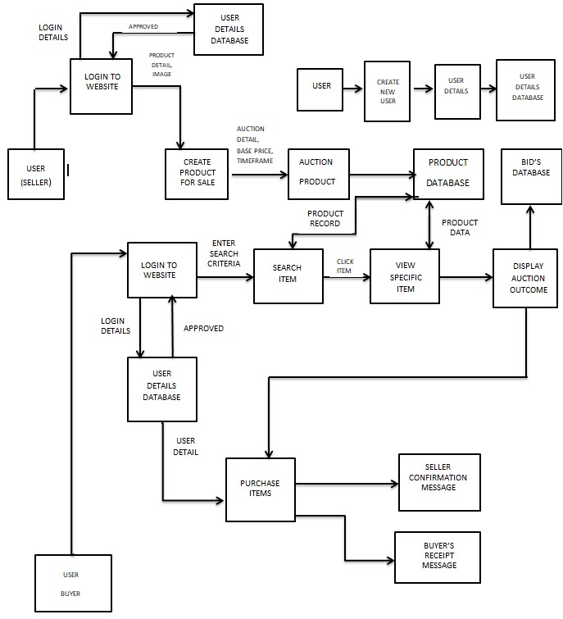
6. Methodology (contd.)

Slide 9
6. Methodology
Item Listing and Bidding
Continue front-end development for item listing creation.
Implement the item listings page with filters and sorting options.
Enable users to create new listings and upload item images.
Begin implementing the bidding functionality.
Auction Logic and Item Management
Implement the core logic for item auctions, including bidding rules and timers.
Develop item management features for sellers, allowing them to edit and relist items.
Enhance the user experience with responsive design and usability improvements.
Start integrating payment processing functionality.
Front-End Development with React
Start front-end development with React.
Create the homepage with featured listings and search functionality.
Implement basic navigation components (e.g., header, footer).
Develop user registration and login forms.
Create User profiles for seller/buyer.
Back-End Development with Node.js
Set up the Node.js server using Express.js.
Implement user authentication and user management routes.
Create API endpoints for user registration and login.
Begin database integration with MongoDB for user data.
Refining front-end side-by-side

Slide 10
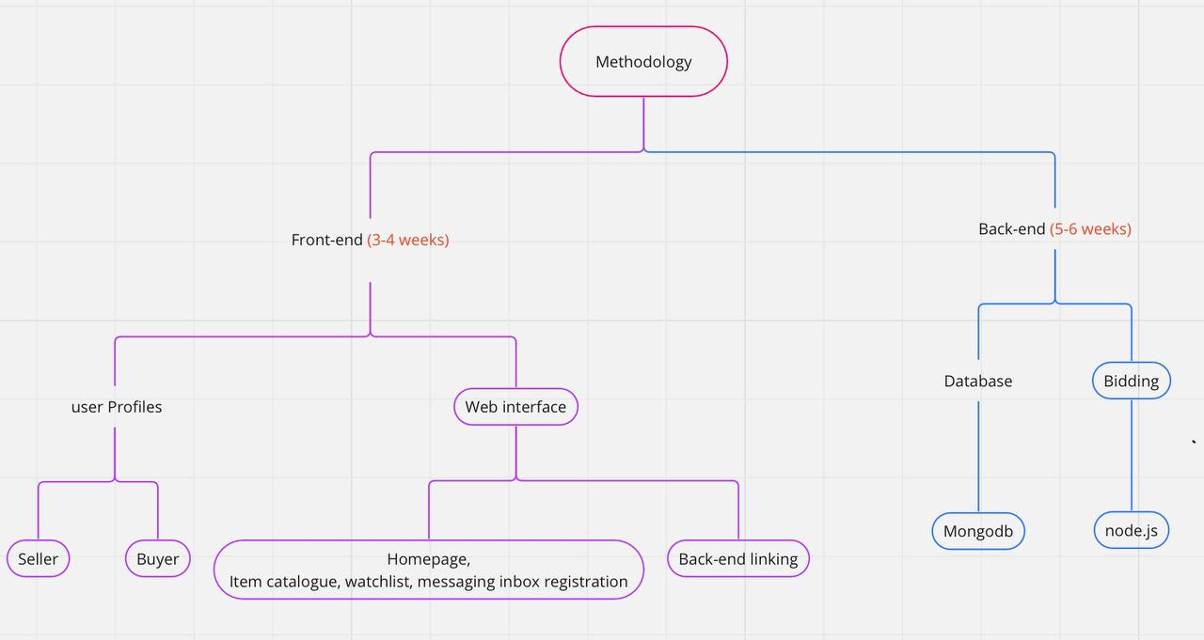
6. Methodology (contd.)

Slide 11
6. Methodology (contd.)​
Data Structures
JavaScript Arrays and Objects
Data Modelling with Mongo
Queue for request processing
Algorithms
Sorting and filtering –quicksort
Search and Query – from mongodb
Bidding Logic

Slide 12
8. Application of the Project
1. eCommerce Platform: can serve as a full-fledged eCommerce platform, allowing individuals and businesses to sell a variety of items, both new and used, through auctions.
2. Collectibles and Antiques: Specialized auction sites cater to collectors and enthusiasts interested in rare collectibles, antiques, art, and memorabilia.
3. Charity Auctions: Nonprofit organizations can use the platform to host charity auctions to raise funds for various causes.
4. Real Estate Auctions: Real estate agencies can use the system to conduct property auctions, making it easier for buyers and sellers to transact in the real estate market.
5. Vehicle Auctions: Your platform can be adapted for selling vehicles, including cars, motorcycles, and boats, attracting both private sellers and dealerships.
6. Business Liquidation: Businesses looking to liquidate assets or inventory can use the platform to reach a wide audience of potential buyers.
7. Government Surplus Auctions: Government agencies at various levels can use the system to auction off surplus equipment, vehicles, and property.

Slide 13
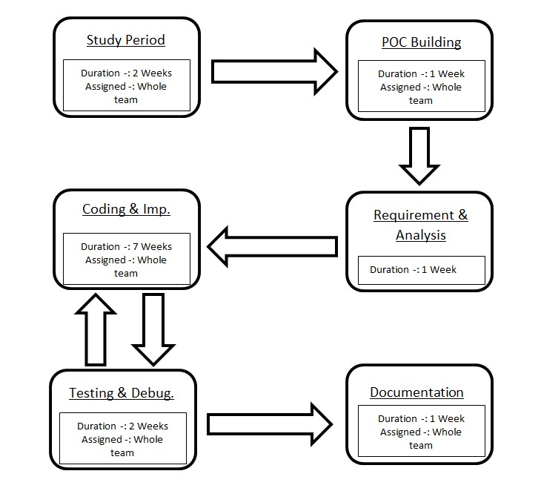
8. PERT Chart

Slide 14
10. References
Building an Autcion Website
HMellor Project
Auction App

Slide 15
Thank You

